Slide 1
Lead Prioritization Agent
Jonathan Luo
5/2/2025

Slide 2




Executive Summary
Objective: Leverage modeling and agentic AI to score and prioritize leads for AEs and RDs
Process: Collect time-series data on historical and open leads to produce comparable, structured textual representations that LLMs can compare and reason through
Implementation: Careful monitoring techniques to ensure the model adds value to the sales process, without interfering with existing best practices and subject matter expertise
Next Steps: Task-specific models to supplement explainable LLM inferences with trained, time-series neural networks

Slide 3
Account Prioritization - Amount of attention a lead requires based on purchase propensity and revenue opportunity.
Determined by 3 primary components:
Customer Profile
Engagement & Shopping Behavior
Pipeline Progress
Firmographics: Industry, scale, core business, market position
Digital maturity: Data operations, technology stack, cyber investment
Risk posture, prior threats
Relatively static attributes
Indirect and direct engagement: Events, demos, website visits, downloads, other interactions
Competition: Competitive solutions engagement, renewal dates, RFP context
Contact decision-making authority
Lead pipeline advancement
Pipeline stagnation
Prospecting
Qualified
Proposal
Negotiation
Conversion
Notes:
Customer awareness is engagement

Slide 4
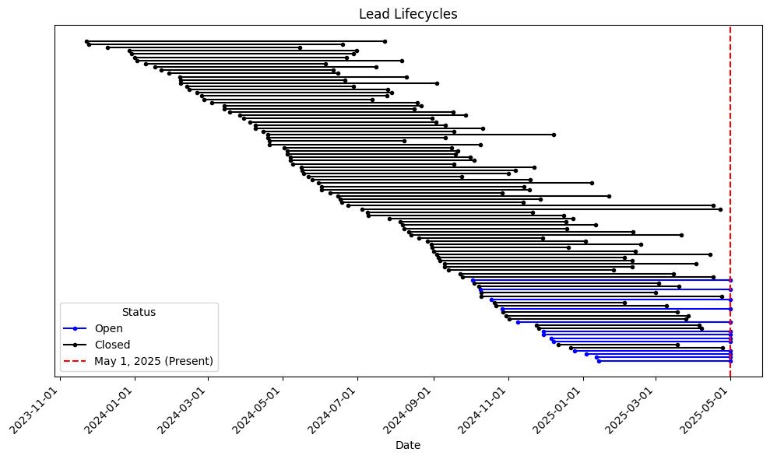



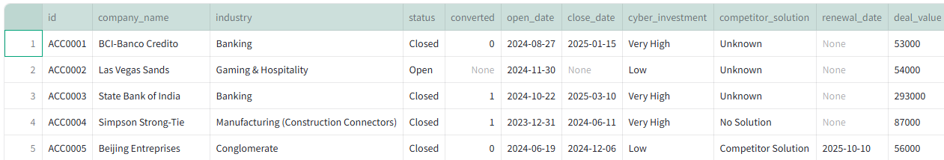
Data and Assumptions
Real company names, industries, and basic firmographics
Mock features, simulated dates, progressions, and outcomes
Assume leads have lifecycle of 3-12 months, skewed right
55 records from customer case studies
All simulated converted
101 generated customer competitors from Gemini
250 random from top 2000 global from Kaggle
…

Slide 5

Baseline Approach
Prompt LLM to provide account prioritization score with lead data input.
Baseline Weaknesses:
Prompt: “Provide a lead priority score for this lead based on…”
1. Ignores historical context and internal sales expertise
Historical lead patterns are not being utilized as effective predictors
2. Lacks temporal detail and nuance
Trends may be major predictors in lead movement
Information about our customer profiles, business model, and strategies are not strongly considered
Lead Account # 1234
Company Name
Industry
Deal Value
Engagement Level
Pipeline Stage
Contact Seniority
.
.
.
GPT-4

Slide 6
Addressing Historical Context
1. Leverage LLM few-shot learning capabilities by providing the model with similar leads for reference
Lead Account # 1234
Company Name
Industry
Deal Value
Engagement Level
Pipeline Stage
Contact Seniority
.
.
.
Lead Account # 1234
Company Name
Industry
Deal Value
Engagement Level
Pipeline Stage
Contact Seniority
.
.
.
Prompt: “Provide a lead priority score for this lead based …
… Use the comparables and broader sales knowledge”
Get top k=5 most similar closed leads
In-Context Learning
Feature Distance Calculation
e.g. Mahalanobis, Gower
Lead Account # 6435
Company Name
Industry
Deal Value
Engagement Level
Pipeline Stage
Contact Seniority
.
.
.
Lead Account # 8654
Company Name
Industry
Deal Value
Engagement Level
Pipeline Stage
Contact Seniority
.
.
.
Lead Account # 1746
Company Name
Industry
Deal Value
Engagement Level
Pipeline Stage
Contact Seniority
.
.
.
Closed Leads
Lead Account # 1746
Company Name
Industry
Deal Value
Engagement Level
Pipeline Stage
Contact Seniority
.
.
.
GPT-4
Lead Account # 9653
Company Name
Industry
Deal Value
Engagement Level
Pipeline Stage
Contact Seniority
.
.
Conversation Status
Results Known
Mathur et al. (2023). In-Context Learning with GPT-4 for Medical Summarization. arXiv. https://arxiv.org/abs/2306.17384

Slide 7
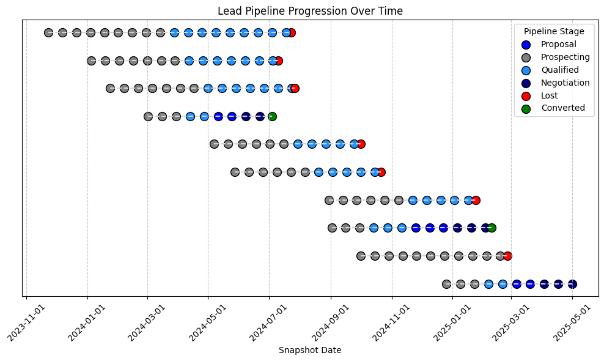
Addressing temporal detail - Snapshot histories to capture nuance
2. Generate “snapshots” of leads at regular intervals and milestone events to track trends (using LLM)
Lead Account # 1234
Company Name
Industry
Deal Value
Engagement Level
Pipeline Stage
Contact Seniority
.
.
.
Lead Account # 1234
Company Name
Industry
Deal Value
Engagement Level
Pipeline Stage
Contact Seniority
.
.
.
Lead Account # 1234
Company Name
Industry
Deal Value
Engagement Level
Pipeline Stage
Contact Seniority
.
.
.
Each circle represents a lead snapshot.
2024-04-03
2025-04-17
2025-05-01
Lead database contains snapshots for all leads every 2 weeks from open to close.
Snapshots allow us to:
Lead Account # 1234
Company Name
Industry
Deal Value
…
Prompt: “Summarize the state and history of this lead…”
Lead Account # 1234
Summary of current lead and history, engagement trends, information discovery, pipeline velocity, changes in contact seniority
Generates temporal-based summary. Done for all leads, open and closed, in database
Lead Account # 1234
Company Name
Industry
Deal Value
…
Lead Account # 1234
Company Name
Industry
Deal Value
…
GPT-3.5

Slide 8
Example: Snapshot Summary Output
Company Summary: Pendo is a technology company that specializes in offering a Digital Adoption Platform to help businesses enhance user experiences and maximize software utilization. With over 500 dedicated employees worldwide and annual revenues exceeding $100 million, Pendo has firmly established itself as a leader in the industry. As a rapidly growing company, Pendo is continuously innovating and expanding its market presence. In terms of technology, Pendo is speculated to have a sophisticated data infrastructure and high digital maturity, allowing for advanced analytics and insights into user behavior. The company likely leverages cloud platforms extensively to scale its services and ensure seamless integration with various software applications. Overall, Pendo's commitment to cutting-edge technology and data-driven solutions positions it as a frontrunner in the competitive digital adoption landscape. Lead Stage: The lead has been open for approximately 20 weeks. The current lead stage is Negotiation, where the lead has been for the past 3 weeks. The lead stage has advanced steadily from Prospecting to Qualified and then to Proposal before reaching the Negotiation stage. Lead Revenue: The most recent known lead deal value is $54,000. Investment: The cyber investment level for the lead is high. The competitor solution is known, and there are approximately 5 months remaining until the competitor's renewal date. Engagement: In terms of engagement, downloads remained consistent at 3, website visits increased from 3 to 7, and interactions increased from 2 to 11. There was a notable spike in interactions during the Negotiation stage. Senior Contact: The current most senior contact holds the title of Exec/CIO/CISO. There was a recent progression in the seniority of the most senior contact 4 weeks ago when the contact changed from a Director to an Exec/CIO/CISO during the Proposal stage.
Structured summaries allow for effective semantic comparison between lead snapshots

Slide 9
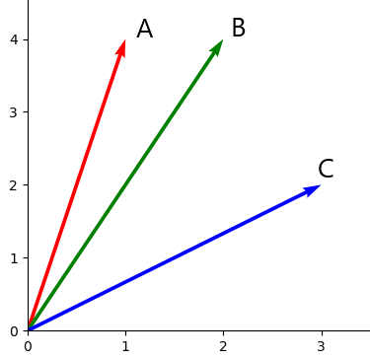
App Architecture – Solution
Leverage LLM few-shot learning capabilities by providing the model with similar leads for reference
Snapshots
Lead Account # 1234
Summary of current lead and history, engagement trends, information discovery, pipeline velocity, changes in contact seniority
Now detailed summaries with historical context. Structured format for semantic comparison
Lead Account # 1234
Summary of current lead and history, engagement trends, information discovery, pipeline velocity, changes in contact seniority
Prompt: “Provide a lead priority score for this lead based …
… Use the comparables and broader sales knowledge”
Get top k=5 most similar closed leads
In-Context Learning
Snapshot Summarize
all-MiniLM-L6-v2
Encoder
Lead Account # 6435
Company Name
Industry
Deal Value
Engagement Level
Pipeline Stage
Contact Seniority
.
.
.
Lead Account # 8654
Company Name
Industry
Deal Value
Engagement Level
Pipeline Stage
Contact Seniority
.
.
.
Cosine Similarity
(For text embeddings)
Lead Account # 1746
Company Name
Industry
Deal Value
Engagement Level
Pipeline Stage
Contact Seniority
.
.
.
Closed Leads
Lead Account # 1746
Company Name
Industry
Deal Value
Engagement Level
Pipeline Stage
Contact Seniority
.
.
.
GPT-4
Lead Account # 9653
Summary of current lead and history, engagement trends, information discovery, pipeline velocity, changes in contact seniority
Conversation Status
GPT-3.5
Now can compare on similar pipeline progressions, engagement trends etc.
Score Outputs:
Company Fit:
Engagement Quality:
Pipeline Progress Potential:
Decreased Data Sparsity
Results Known
Lead Prioritization Score:

Slide 10
Example: Lead Prioritization Output
1. Company Fit: 90 Pendo aligns very well with the company’s ideal customer profile. As a tech leader with a sophisticated data infrastructure, high digital maturity, and a high cyber security investment level, they fit the profile of companies that have successfully converted in the past. Their deal value is also within the range of the comparable leads, and their size and scale are indicative of a company that can potentially invest in our solutions. 2. Engagement Quality: 85 The lead has shown good engagement with consistent downloads, an increase in website visits, and a significant increase in interactions. The fact that the seniority of the contact has progressed to an Exec/CIO/CISO level is a positive sign, as decision-makers are now involved. The competitor's renewal date being 5 months away also provides a potential window of opportunity. 3. Pipeline Progress Potential: 80 The lead is currently in the Negotiation stage, which is a late stage in the pipeline. This means our sales team has done a good job of moving them through the sales process. However, based on our comparable leads, leads at this stage can either convert or not, so it's essential to continue nurturing this lead to increase the likelihood of conversion. Lead Priority Score: 85 Recommendations: 1. Continue to engage with the Exec/CIO/CISO, providing them with personalized content that addresses their specific needs and concerns.
2. Given that the competitor's renewal date is in 5 months, it's crucial to highlight the advantages of our solution over the competitor's product. Offering a side-by-side comparison and demonstrating superior value could be beneficial. 3. As the lead is in the Negotiation stage, it may be worth offering a pilot or trial period to help them see the value and effectiveness of our solution first hand.
Scores broken down by clear, pre-defined components to empower AEs, RDs, and other users the flexibility of interpretation and explainability
Recommendations provided for AEs and other users to consider should they prioritize or work the lead

Slide 11
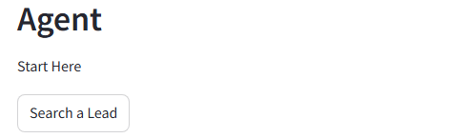
Demo

Slide 12
LLM Priority Scoring – Interpret with Caution
LLMs like GPT-4 are effective for context-learning, reasoning, and explainability. However, the inherent design of language prediction introduces randomness and inconsistency that is more obvious in numbers than sentiment.
ACC0017 | 1 | 2 | 3
Fit | 90 | 85 | 90
Engagement | 85 | 90 | 85
Pipeline | 80 | 80 | 80
Prioritization | 85 | 85 | 85
ACC0002 | 1 | 2 | 3
Fit | 85 | 85 | 75
Engagement | 35 | 45 | 45
Pipeline | 40 | 55 | 60
Prioritization | 53 | 62 | 60
ACC0114 | 1 | 2 | 3
Fit | 80 | 85 | 90
Engagement | 70 | 75 | 85
Pipeline | 85 | 80 | 80
Prioritization | 78 | 80 | 85
Re-runs in quick succession for 3 random examples
Variations in figures despite detailed prompt instructions and identical data at each iteration
Tendency to provide scores that are multiples of 5 (imitative of human)
Consistently calculates prioritization score as the average of the other 3 preceding scores (not explicitly instructed)
LLMs’ scoring is based on language-derivation and creativity rather than traditional, math-based calculations. Scores should be interpreted and ranked less literally.
Notes:
Demonstrates the lesser traditional math-faithfulness of LLMs
Like asking a SME for an estimate, not someone who is doing official math-derived calculations.

Slide 13

Implementation – A careful process
Avoid this – Unchecked self-fulfilling prophecy
Background Implementation
Implement silently, without direct influence on user behavior
Delayed benefit
A/B Testing
Randomize implementation across AEs with similar portfolios to compare performance
Blind Recommendations
If AEs are unaware of the model, provide nudges toward model-recommended accounts to track AE response
May not be strong enough signal to influence change nor represent real-world usage
Full Transparency
Track prioritization score and lead predictions against existing metrics and outcomes
Performance and incentive concerns
May require significant amount of time and volume to reach statistical power
Communication and transparency on model influence and performance. Reflect on differences, blind spots, strengths/weaknesses of current system and new model
Lead Prioritization Model
Lead prioritization score is highly dependent on sales team action, which can blur the understanding of model performance and value
High Priority:
Low Priority:
Lead Account
#1234
…
Lead Account #6789
…
Lead Account # 1234
…
Lead Account # 1234
…
Lead Account # 1234
…
Lead Account # 1234
…
AE’s engage with model-recommended accounts more, regardless of actual lead quality
AE’s ignore lower model-recommended accounts, regardless of actual lead quality
Potential Blind Spot: Higher model-ranked leads convert at a higher rate, because it influenced user prioritization behavior, while better value leads were ignored.

Slide 14
Future Considerations
Data Quality
Collect feedback and quality, ground-truth summaries from sales professionals on summarization quality, improving summarization relevance, accuracy, and inference power
Deeper Context for In-Context Learning
Current matches lead snapshots are sent with their conversion status. However, providing LLMs with entire histories of where they ended up may provide better context for how a lead may develop
Agent automatically updates data and text fields based on discussion and correction from AEs and other users
Long-term Temporal Context
Market conditions and internal factors change over time. In the long-term, distributional shifts between present and past data may bias similarity calculations and priority scoring.
Deep Learning
Neural networks may provide strong scoring performance through conventional math-based calculations, at cost of explainability.
Output can be used to supplement LLM explainability, which is paramount in sales communications
NN can be time-series trained, leveraging all history for training data and learning temporal trends

Slide 15
Thank you

